Slide 1
Scientific Method
Not a method per se but a philosophical outlook characterized by:
Empirical Reasoning.
Experimental and non-experimental techniques.
Methods of external observation and reporting.
Quantitative and qualitative procedures.
Notes:
Tiger Deer Tiger Deer Tiger Deer Tiger Deer Tiger Deer Tiger Deer Tiger Deer Tiger Deer Tiger Deer Tiger Deer Tiger Deer Tiger Deer Tiger Deer Tiger Deer Tiger Deer, in preso
Some bullets:
We
Got
this

Slide 2
Research Approaches
Descriptive.
Relational.
Experimental.

Slide 3
Descriptive Research
The first step in the research process.
Mapping out the territory.
Systematic, careful description of what is happening and where it happens.
Doesn't really tell us why something is happening or how it happens.
Example: Ethnographic research.
Notes:
New notes 2 Tiger Deer Tiger Deer Tiger Deer Tiger Deer Tiger Deer Tiger Deer Tiger Deer Tiger Deer Tiger Deer Tiger Deer Tiger Deer Tiger Deer Tiger Deer Tiger Deer Tiger Deer, in preso
Some bullets:
We
Got
this

Slide 4

Descriptive Research: Example Washington Post/ABC Poll 5/12/06
http://www.washingtonpost.com/wp-srv/politics/polls/postpoll_nsa_051206.htm

Slide 5
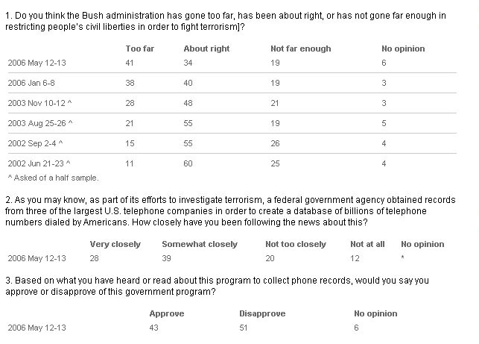
Descriptive Research: Example: USA Today Poll 5/14/06
http://www.usatoday.com/news/washington/2006-05-14-nsa-reax-poll_x.htm

Slide 6
Systematic Observation
Systematic observation differs from casual observation in that it uses a methodology that can be evaluated based on certain technical standards.
Quantitative –data recorded in numeric form.
Qualitative- data recorded in any number of non-numeric ways: recorded conversation, videotape, writing.

Slide 7
Types of Systematic Observation
Participant observation.
Ethnography.
Secondary Observation and Content analysis.
Experimental simulations.
Unobtrusive observation.

Slide 8
Relational Research
Often this is the next step in research.
When two or more things are measured, are they related to one another?
Relational question: Is presidential approval related to ethnicity?
Statistics in relational research are both descriptive and inferential (involves making a statement about the likelihood of our observation).
Often leads to the formation of hypotheses.

Slide 9
Experimental Research
Focus of experimental research is on determining how or why something occurs.
Experimental research often involves the systematic manipulation of conditions and careful measurement of outcomes to determine causes.

Slide 10
Definitions
Constructs.
Variables.
Independent variables.
Dependent variables.
Discrete and continuous data.
Descriptive Statistics.
Inferential Statistics.

Slide 11
Construct
Theoretical concepts formulated to serve as causal or descriptive explanations.
Examples:
Self Esteem
Depression
Introversion/extroversion.
Diffusion of responsibility

Slide 12
Variable
A variable is an event or condition that the researcher observes or measures or plans to investigate that is likely to vary (or change).
Dependent variables (DV) refer to the "effect" or "outcome" in which the researcher is interested.
Independent variables (IV) refer to the presumed "cause" . Changes in this lead to changes in the dependent variable.
Note that independent and dependent are very much defined by the research question.

Slide 13
Examples: Name the IV and DV
Exercise decreases depression.
Girls who diet at an early age are more likely to develop eating disorders.
Schizophrenics with tardive dyskenia are more likely to die than those without the disorder.
CBT is more effective than non-directive supportive therapy in reducing anxiety symptoms in adolescents.

Slide 14
Discrete and Continuous Data
Discrete data have values that can only assume whole numbers.
For example, children only come in whole units, there aren't really 2.2 children. Besides, have you ever tried to shop for a .2 child?
Continuous data can take any value within a defined range.
For example, height , weight and time are really continuous; we impose arbitrary measuring limits on them.

Slide 15
Statistics: primary types
Descriptive statistics are concerned with the presentation, organization, and summarization of data.
Inferential statistics allow us to generalize from our sample of data to a larger group of subjects.

